Slide 1
Familiarize yourself with phishing attacks
(Specially HR and Marketing Teams) Phishing attacks are a form of cybercrime in which attackers use deceptive tactics to trick individuals into revealing sensitive information, such as passwords, credit card details, or personal data. These attacks commonly occur via email, but can also happen through other communication channels like text messages, social media, or phone calls.

Slide 2
What is phishing?
Phishing attacks are a form of cybercrime in which attackers use deceptive tactics to trick individuals into revealing sensitive information, such as passwords, credit card details, or personal data. These attacks commonly occur via email, but can also happen through other communication channels like text messages, social media, or phone calls.
Here are some common characteristics and techniques used in phishing attacks:
Spoofed or deceptive email addresses: Attackers often create email addresses that appear legitimate or mimic a trusted organization or individual. They may use similar domain names or slight variations to deceive recipients.
Urgent or alarming language: Phishing emails typically employ urgency or fear to prompt immediate action. They may claim an account has been compromised, a payment is overdue, or a deadline is approaching, creating a sense of urgency that prompts the recipient to act hastily.
Request for sensitive information: Phishing emails often request recipients to provide sensitive information such as passwords, credit card numbers, social security numbers, or login credentials. Legitimate organizations generally do not ask for such information via email.
Suspicious attachments or links: Phishing emails may contain attachments or links that, when clicked or opened, can install malware or direct the user to a malicious website designed to capture sensitive data. These attachments or links are often masked to appear legitimate.
Poor grammar and spelling: While some phishing attempts have improved in this area, many still exhibit spelling mistakes, grammatical errors, or awkward language usage. However, it's important to note that sophisticated attackers may craft more convincing emails with proper grammar and spelling.

Slide 3
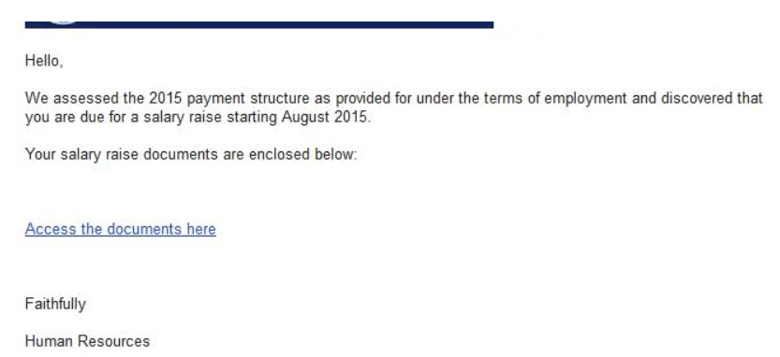
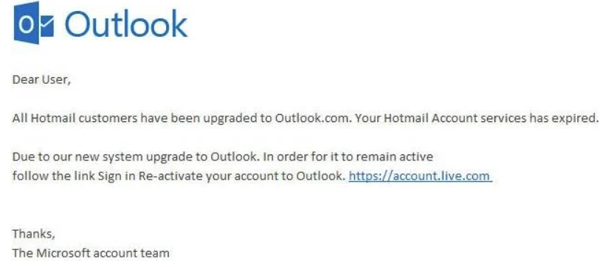
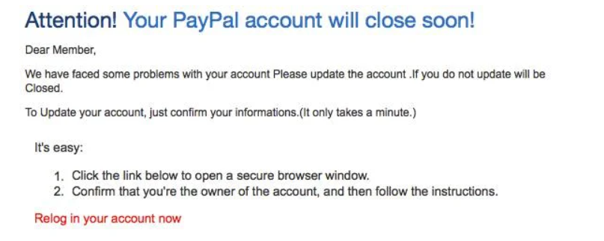
Learn to spot phishing emails

Slide 4
How do we stop getting phished?
To protect yourself from phishing attacks, it's essential to:
Verify the sender: Check the email address and domain carefully to ensure it corresponds to a legitimate source. Be cautious of any discrepancies or suspicious variations.
Think before you click: Avoid clicking on links or downloading attachments from unsolicited or suspicious emails. Hover over links to preview the actual URL before clicking.
Be cautious with personal information: Never provide sensitive information through email or other unsecured channels. Legitimate organizations usually have secure methods for collecting such data.
Stay updated and educated: Stay informed about the latest phishing techniques and learn to recognize the signs of phishing attacks. Regularly update your computer's security software and be cautious of any unexpected or unusual communications.
By remaining vigilant, practicing good email hygiene, and being cautious online, you can significantly reduce the risk of falling victim to phishing attacks.

